Slide 1
Additional Topics – Part 2

Slide 2
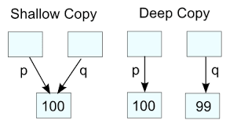
Topics
Shallow vs. deep copy
Virtual Functions
Abstract classes
More on casting
Event based programming

Slide 3

Shallow Copy vs. Deep Copy
A shallow copy copies only the class data members
Does not make a copy of any pointed to data
Shares any pointed-to dynamic data with the original class object
A deep copy copies not only the class data members
Makes a separate stored copy of any pointed-to data
Makes its own copy of the pointed-to dynamic data at different locations than the original class object

Slide 4
Problems Doing a Shallow Copy
7
4
2017
Fourth of July
message
7
Two objects pointing to the same
memory location
1. Changing string affects both objects
2. Deleting string affects both objects
4
2017
message

Slide 5
Deep Copy
7
4
2017
Fourth of July
message
7
Fourth of July
4
2017
Two objects pointing to the different
memory locations
1. Changing a string affects only one object
2. Deleting a string affects only one object
message

Slide 6
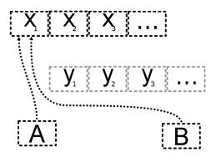
Initialization of Class Objects
Initialization means
Initialization in a variable declaration
object object1=object2; // not the assignment operator
Passing an object argument by value (copy)
myFunction(object1)
Returning an object as the return value of a function (not by reference)
return (object1)
By default, C++ uses shallow copies for these initializations

Slide 7
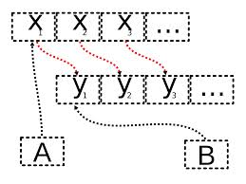
Classes using Dynamic Memory
When dealing with classes that use dynamic memory (common with pointers), one must define
Class constructor (other than the default)
Class destructor
When a class variable (that uses dynamic memory) goes out of scope, the memory for data members including pointers is deallocated
Should deallocate the dynamic memory pointed to by the data member
Dynamic memory to is not automatically deallocated
Copy constructor
(Optionally) a deep copy function or method
(Optionally) an assignment operator that performs a deep copy

Slide 8
Destructor Issues
7
4
2017
Fourth of July
message
Default destructor does not delete the pointed to data

Slide 9
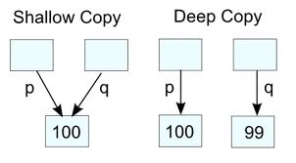
Copy Constructor
When present (default shallow copy is not done), it is implicitly called in initialization situations
Should be written to make a deep copy of the dynamic data into different memory locations
Syntax:
className (const className& objectName); // copy constructor
Like other constructors, it has no return type
Clients CANNOT invoke the copy constructor directly
A deep copy function may also be written
See examples: dynamic8.cpp and dynamic9.cpp

Slide 10
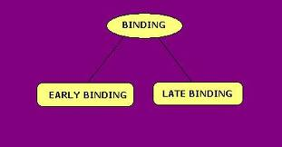
Static Vs Dynamic Binding
Static Binding
Is the compile-time determination of which function to call for a particular object based on the type of the formal parameter
Dynamic Binding
Is the run-time determination of which function to call for a particular object

Slide 11
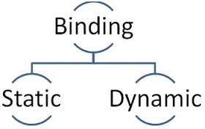
Static Binding Is Based on Formal Parameter Type
For example:
….
Time startTime(6,30,0) ;
ExtTime endTime(5,0,0,PST) ;
….
startTime.write()
endTime.write()
….
startTime.write() // invoke the Write() function from the Time class
endTime.write() // invoke the Write() function from the ExtTime class
The determination to invoke the proper Write() function is done at compile time
Static Binding

Slide 12

Passing Class Objects as Arguments
The basic rule for passing class objects as arguments is that the actual argument and the corresponding formal parameter must be the same type
The parameters on the invocation must be the same type as defined on the function
This rule is relaxed when dealing with inheritance
When the type of a formal parameter is a parent class, the argument used can be:
The same type as the formal parameter (parent class) or any descendant class type

Slide 13

Passing Class Objects as Arguments (2)
Compilers use a set of rules to determine the binding of an function when an class object is passed as an argument
One can pass an object of a child class to a function that expects an object of a parent class but not visa versa

Slide 14
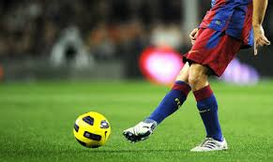
Passing Class as Arguments (3)
A single function can handle parent class objects and all descendant class objects
Instead of writing a different function for each type of object
For example, a single print function can handle the Time objects as well as all of the Time’s descendant objects

Slide 15

Slicing Problem
When an object of a child class is passed to a function that expects an object of its parent class using passing by value
Only the data members in common are passed
Static binding occurs
The child usually contains more data members
The extra data members are “sliced off”
This slicing also occurs using the assignment operator
parentClassObject = childClassObject

Slide 16
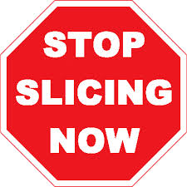
Slicing Problem Illustrated
…
Time startTime (8,45,0);
ExtTime thisTime ( 8, 35, 0, PST ) ;
...
Print(startTime);
Print(thisTime);
….
void Print (Time someTime) // pass by value
{
someTime.Write();
}
Time is 08:45:00
Time is 08:35:00
Note: timezone is not printed
See virtual1.cpp

Slide 17

Avoiding the Slicing Problem
When passing by reference, the slicing problem does not occur since the address of the argument is sent to the function and no copy is done
However static binding still occurs
Compilers will generate code to call the base class’s function
Adding the word virtual at the beginning of the function declaration (prototype)
Instructs the compiler to generate code that dynamically binds a function to an object

Slide 18

Time Specification - virtual Write( )
class Time
{
public :
void Set ( int hours , int minutes , int seconds ) ;
void Increment ( ) ;
virtual void Write ( ) const ;
Time ( int initHrs, int initMins, int initSecs ) ;
Time ( ) ;
private :
int hrs ;
int mins ;
int secs ;
} ;

Slide 19

Slicing Problem Solved
…
Time startTime (8,45,0);
ExtTime thisTime ( 8, 35, 0, PST ) ;
...
Print(startTime);
Print(thisTime);
….
void Print (Time& someTime) // pass by reference
{
someTime.Write(); // upcasting
}
Time is 08:45:00
Time is 08:35:00 PST
See virtual2.cpp thru virtual4.cpp

Slide 20
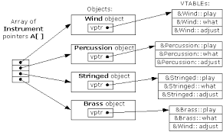
Virtual Methods Explained (1)
A compiler creates a single table (called the VTABLE) for each class that contains virtual functions
The compiler places the addresses of the virtual functions for that particular class in the VTABLE
For each class with virtual functions
A pointer, called the vpointer (VPTR), which points to the VTABLE for that object is created

Slide 21
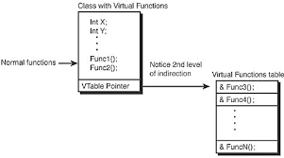
Virtual Methods Explained (2)
When one makes a virtual function call through a base-class pointer (that is, when one makes a polymorphic call), the compiler inserts code to fetch the VPTR and look up the function address in the VTABLE, thus calling the correct function and causing late binding to take place
Setting up the VTABLE for each class, initializing the VPTR, inserting the code for the virtual function call – happens automatically

Slide 22

Dynamic Binding Summary (1)
Declaring a member function to be virtual
Instructs the compiler to generate code that performs dynamic binding
Determination of what function to call is done at run time
Dynamic binding requires pass-by-reference when passing a class object to a function
In the declaration for a virtual function, the word virtual appears only in the base class

Slide 23
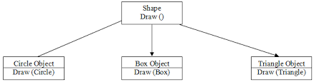
Dynamic Binding Summary (2)
A derived class is not required to re-implement a “virtual” function
If it does not, the base class version is used
A derived class cannot redefine the function return type of a virtual function

Slide 24
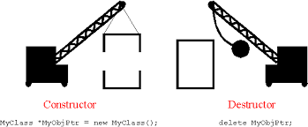
Classes and Virtual Destructors
If a derived class object is passed to a formal parameter of the base class type, the destructor of the base class is called when the derived class object goes out of scope
If the derived class contains pointer variables
The derived class destructor should be called to de-allocate memory
If the destructor of the base class is virtual, this will occur
If the base class contains virtual methods, then one should make the destructor virtual

Slide 25
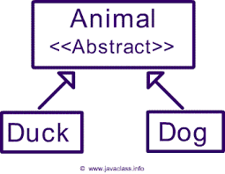
Abstract Classes and Pure Virtual Functions (1)
The base class can contain functions that you would want each derived class to implement
The base class may contain functions that may not have meaningful definitions in the base class
For example, for the class Shape
The draw () and move () make sense only if the shape is defined (square, rectangle, circle, etc.)
virtual void draw ()
virtual void move (double x, double y)

Slide 26
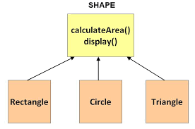
Abstract Classes and Pure Virtual Functions (2)
To prevent someone from invoking draw () and move () for a class shape object, use the following
virtual void draw () = 0;
virtual void move (double x, double y) = 0;
This construct will create pure virtual functions
A class that contains a pure virtual function is call an abstract class
One cannot instantiate abstract classes since all the methods are not implemented
The derived class must implement the pure virtual functions Note: a constructor cannot be virtual

Slide 27
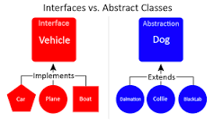
Abstract Classes and Pure Virtual Functions Example
class employeeType
public:
virtual void print() const = 0;
class fullTimeEmployee: public employeeType
public:
void print() const
virtual setId(long id);
fullTimeEmployee must have a print() method defined

Slide 28

Variant Return Type
One cannot modify the return type of a virtual function during overriding
However there is a special case in which one can slightly modify the return type
If one is returning a pointer or a reference to a base class, then the overridden version of the function may return a pointer or reference to a class derived from what the base returns

Slide 29
Casting

Slide 30

Static_casting
Static_casting is explicit
As opposed to implicit coercion
Can also take the form data (expression)
C-like casting
For example int (17.6) = 17
Static_casting is prefer over the C-like casting
See cast1.cpp

Slide 31


Upcasting vs Downcasting
Upcasting – moving up an inheritance hierarchy
When upcasting, it is always clearly derived from an ancestor class
Downcasting – moving down an inheritance hierarchy
When downcasting, there are usually several possibilities that one could cast
vs

Slide 32
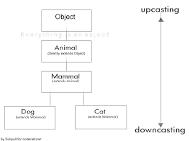
Upcasting vs Downcasting Example
A Circle is a type of Shape (that’s the upcast), but if you try to downcast a Shape it could be a Circle, Square, Triangle, etc.
But an even more important issue is asking why one is downcasting in the first place instead of just using polymorphism to automatically figure out the correct type

Slide 33
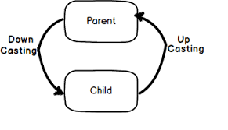
Upcasting
Converting a derived-class reference or pointer to a base-class
Allows one to treat a derived type as though it were its base type
It is always allowed for public inheritance, without an explicit type cast
This is a result of the is-a relationship between the base and derived classes
See cast2.cpp

Slide 34

Downcasting
C++ provides a special explicit cast called dynamic_cast that is a type-safe downcast operation
When one uses dynamic_cast to try to cast down to a particular type, the return value will be a pointer to the desired type only if the cast is proper and successful otherwise it will return zero to indicate that this was not the correct type

Slide 35

More on Downcasting
The dynamic_cast operator is used for downcasting a reference or pointer to a more specific type in the class hierarchy
Unlike the static_cast, the target of the dynamic_cast must be a pointer or reference to a class
Unlike static_cast (where type check is made during compilation), a type safety check is performed at runtime
If the types are not compatible, an exception will be thrown (when dealing with references) or a null pointer will be returned (when dealing with pointers)
The need for dynamic_cast generally arises because one wants perform derived class operation on a derived class object, but one has only a pointer-or reference-to-base

Slide 36

Dynamic_casting Syntax
Child *p = dynamic_cast<Child *>(pParent)
See cast3

Slide 37
Event-based Programming

Slide 38
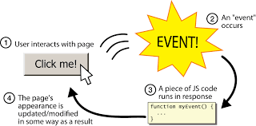
Event-based Programming Definition
Event-driven programming is a paradigm in which the flow of the program is determined by events, such as user actions (mouse clicks, key presses), sensor outputs, or messages from other programs/threads
Event-driven programming is the dominant paradigm used in graphical user interfaces GUI) and other applications (e.g. web applications) that are centered on performing certain actions in response to user input

Slide 39

Event-based Programming
In an event-driven application, there is generally a main loop that listens for events, and then triggers a callback function when one of those events is detected
In embedded systems the same may be achieved using hardware interrupts instead of a constantly running main loop
Such as stepping on a brake pedal

Slide 40

Event-based Programming
Window-based GUI’s are typically comprised of many independent processes
These processes sit and wait for the user to do something, to which it can respond
A simple application may be waiting for any of a number of things
Provided by QT

Slide 41
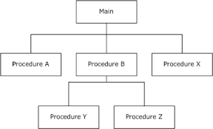
Programming Paradigms
Procedural programming
code is executed in sequential order
Event-driven programming
code is executed upon activation of events
statement 1
statement 2
statement 3
--------
--------
statement n

Slide 42
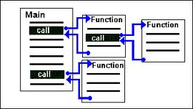
Procedural Programming (1)
Execution starts at main() and executes statement sequentially branching with if, for, and while statements, and occasional method calls
When one needs user input one calls read() on the console stream which waits (blocks) until the user types something, then returns

Slide 43
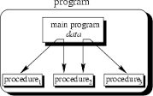
Procedural Programming (2)
One problem with this model is: How do we wait for and respond to input from more than one source (e.g. keyboard and mouse)
If one of the blocks is waiting for input, one may miss input from the other

Slide 44
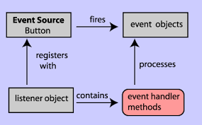
Event-driven Programming
The application waits for user input events, and these events trigger program methods
Event-based programming addresses the two problems:
How to wait on multiple input sources (input events)
How to decide what to do on each type of input event

Slide 45
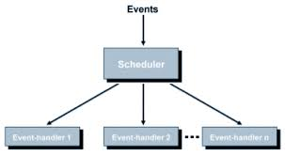
Event Loop Example
Because the code for checking for events and the main loop do not depend on the application, many programming frameworks take care of their implementation and expect the user to provide only the code for the event handlers
main(){
...set up application data structures...
...set up GUI....
// enter event loop
while(true){
Event e = get_event();
process_event(e); // event dispatch routine } }

